Slide 1




Children’s Rights and
the Senedd Election

Slide 2

2026 Senedd Election
The election will take place on 7 May 2026
You need to be 16 and living in Wales to vote in this election
You must register to cast your vote
You have a right to have your say, and casting your vote in the Senedd election is one way you can have your say
Notes:
This slide can be used to introduce the election.
Key info:
The election will take place on 7 May 2026
You need to be 16, living in Wales and registered to vote to vote in this election
You will be voting for the political party or independent candidate you want to represent you in the Senedd
You have a right to have your say, and casting your vote in the Senedd election is one way you can have your say and make your voice heard

Slide 3
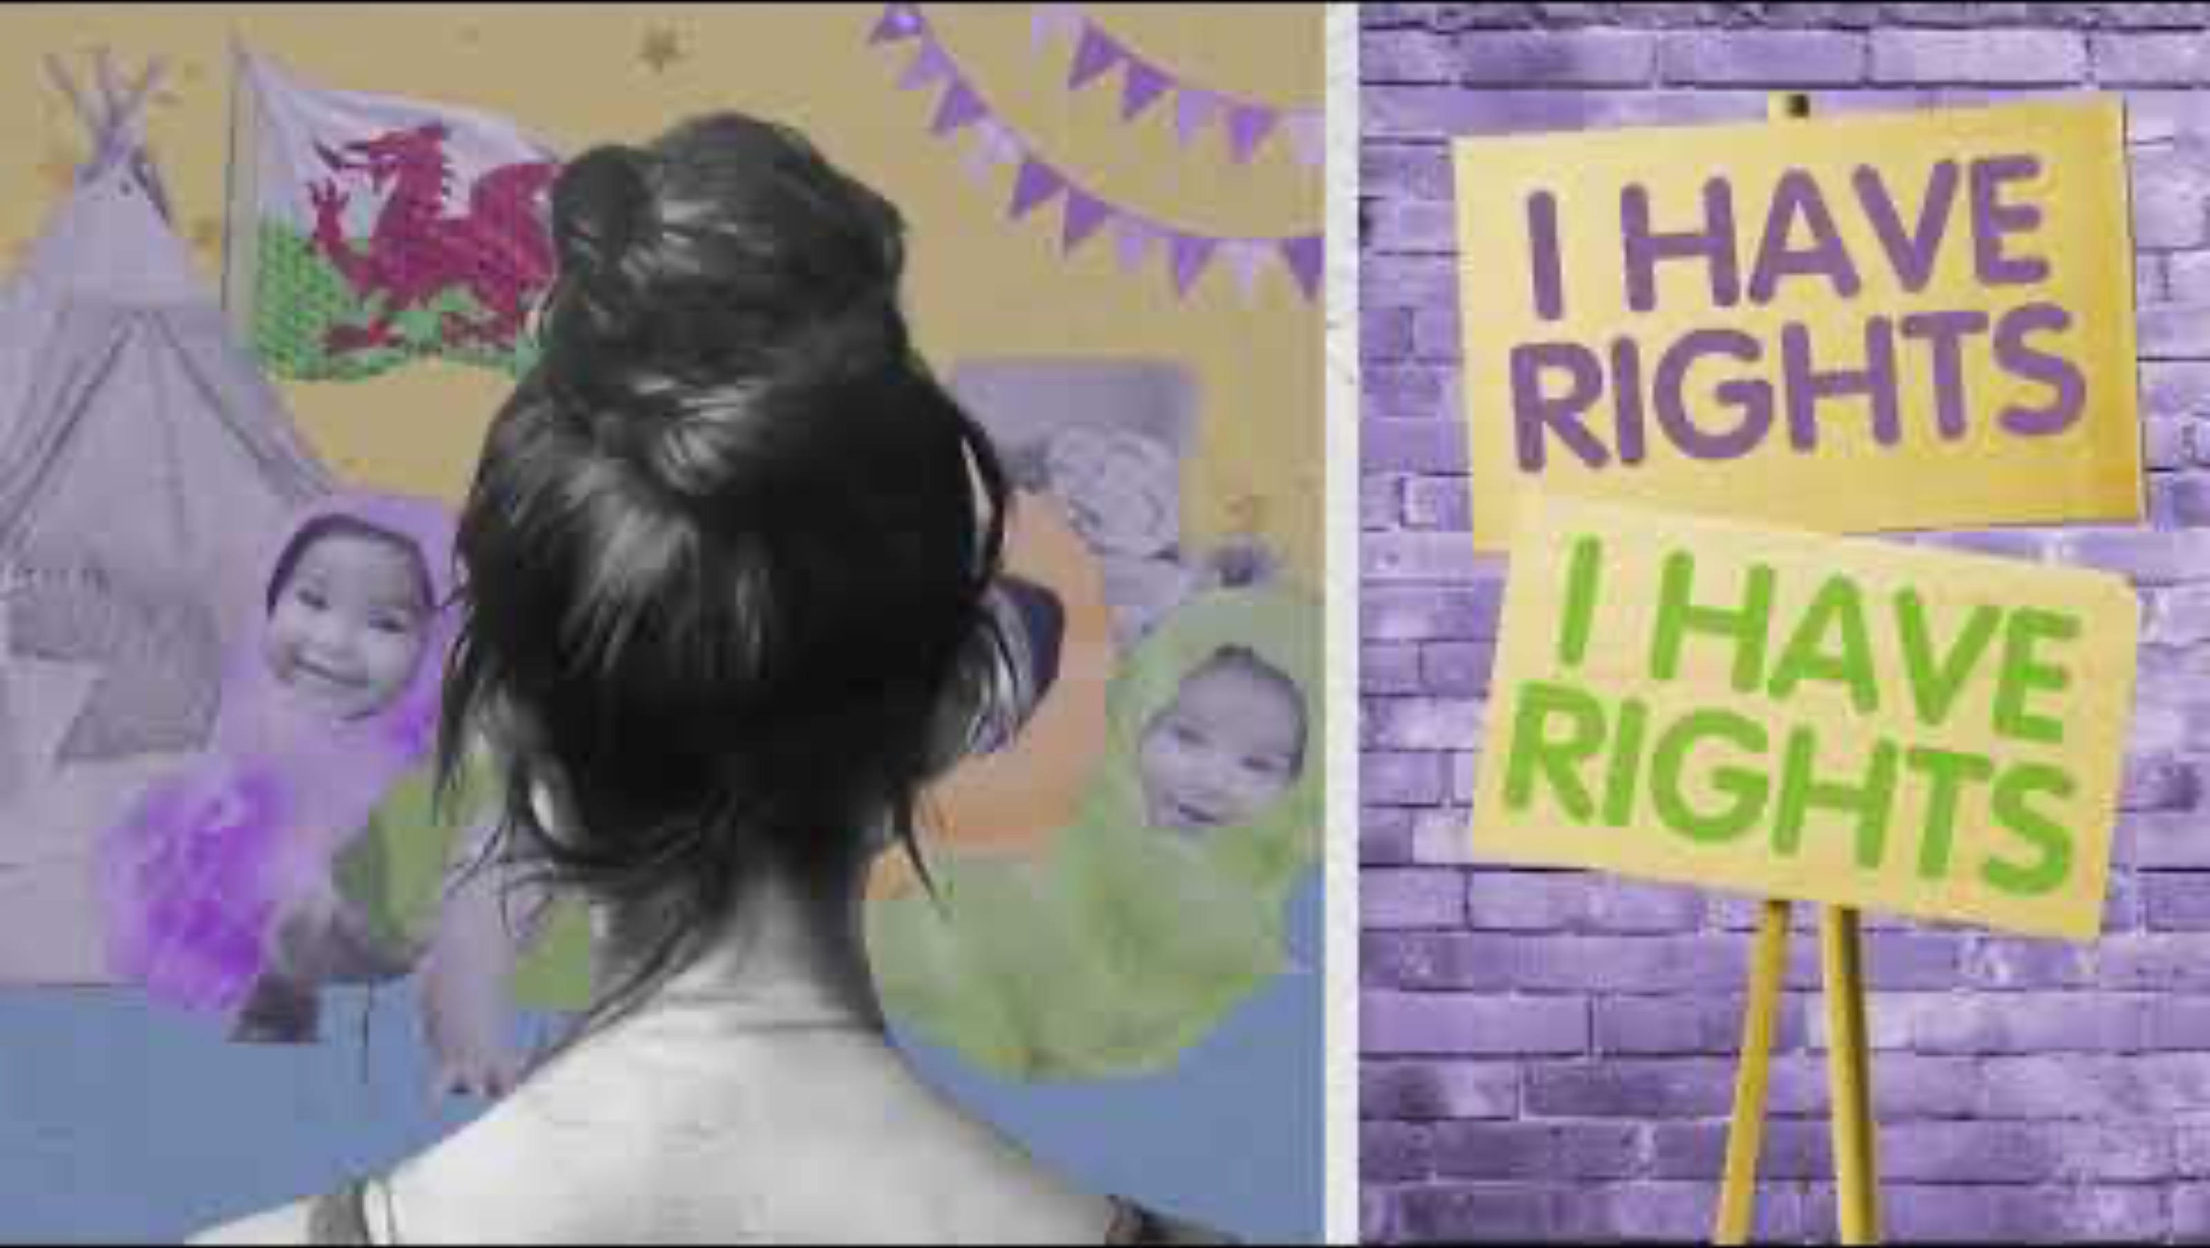
Notes:
Watch the video about children's rights.
Explain to pupils that in this session you will be thinking about children’s rights and how it links to voting in the Senedd election.
“Children’s rights are the things you need to grow up feeling happy, healthy and safe. Everyone child and young person in Wales has these rights.”

Slide 4
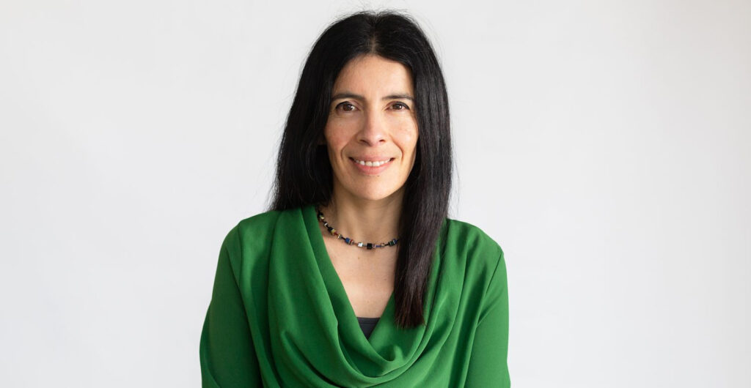

In Wales, there is a person called the Children’s Commissioner. It’s their job to stand up for your rights.
Rocio Cifuentes is the current Children’s Commissioner for Wales.
She is not a part of the Welsh Government. It’s her job to tell the Government what they need to do to protect children’s rights.
Notes:
Explain that there is a person whose job it is to stand up for their rights.

Slide 5


Activity: Body of rights
  Draw an outline of a body
  Work together to think about all the things you need to grow up feeling happy, healthy and safe
  Write/draw them inside your body
  Use a ‘Know your rights’ poster - see if your thoughts match any of your rights.
  Think about the things that young people are denied - write them around the outside of the body
  Feedback to the rest of the class/ group
Notes:
Facilitate the activity.
Know Your Rights poster or Symbols Pack.

Slide 6

Feeling worried?
Notes:
You can use these slides to remind pupils about who they can talk to if they are worried about being denied their rights.

Slide 7



Contact a support service like Childline or MEIC.
Speak to an adult you trust in school.
Speak to an adult you trust at home.
Notes:
You can use these slides to remind pupils about who they can talk to if they are worried about being denied their rights.

Slide 8


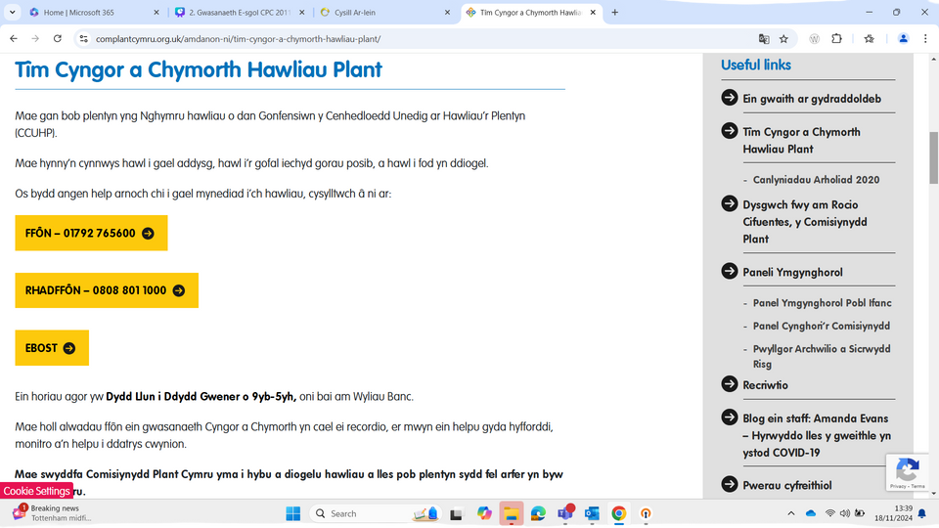


Ddim yn derbyn eich hawliau?
Not getting your rights?
Gallwch gysylltu gyda’n tîm cymorth a chyngor trwy:
  ffonio: 01792 765600
  e-bostio cyngor@complantcymru.org.uk
  danfon neges ar y wefan
You can contact our advice and assistance team by:
  calling 01792 765600
  emailing post@childcomwales.org.uk
  send a message via the website
Notes:
You can use these slides to remind pupils about who they can talk to if they are worried about being denied their rights.

Slide 9
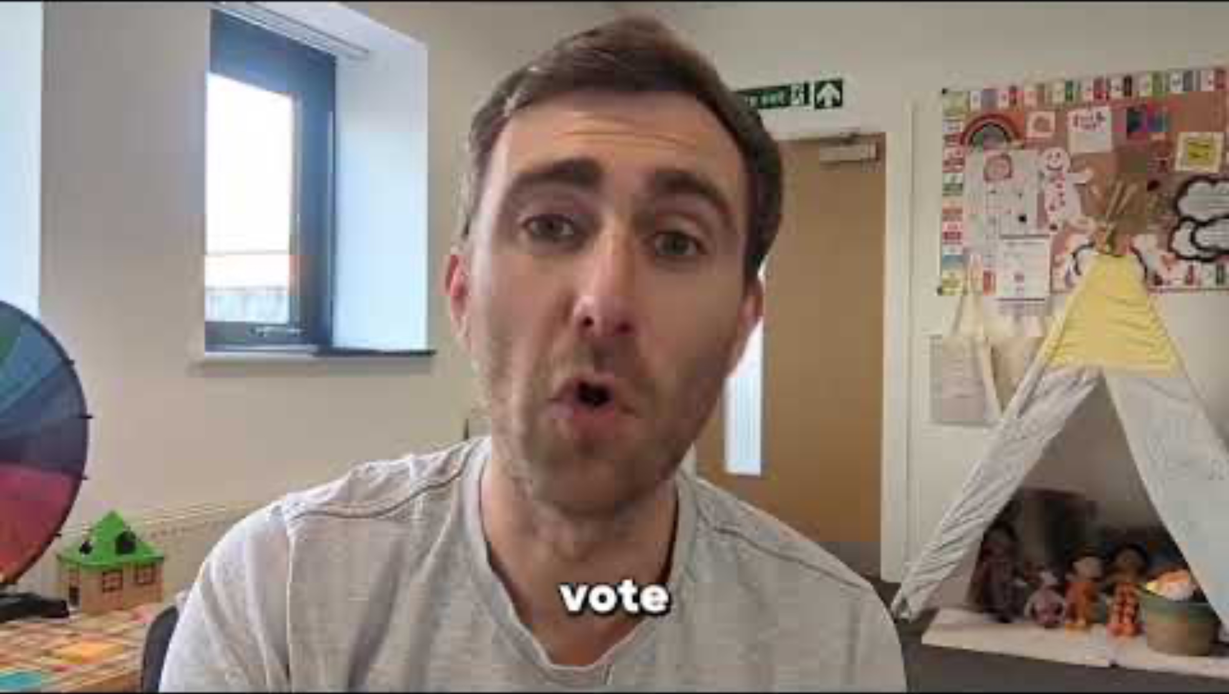
Notes:
Play the video.
Highlight that you have a right to have your say, and casting your vote in the Senedd election is one way you can have your say and make your voice heard.

Slide 10
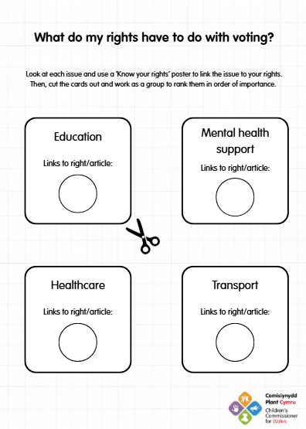

How do my rights link to voting in Wales?
Using the worksheet:
  Match your rights to the issues. All of the issues can be affected by politicians in the Senedd.
  Cut the issues out
  Work as a team to rank them in order of importance
  Feedback to the whole group/ class
Notes:
Facilitate the activity.
Worksheet: https://drive.google.com/file/d/1k9fxqVTxZe-lHkmWhW7EOIW4CH51F55q/view?usp=drive_link

Slide 11
🤔 What issues are important to you? Can anyone link an issue to one of your rights?
📣 How can you have your say on these issues in your school, community, or nationally?
‼️ And remember - to have your say as part of the election, you need to register to vote. It’s quick, easy, and you can do it all online.
Notes:
Wrap up the session by reflecting on these questions.

