Slide 1




Children’s Rights and
the Senedd Election
Notes:
These short activities will explore how children's rights relate to the Senedd election.

Slide 2
2026 Senedd Election
The election will take place on 7 May 2026
You need to be 16 and living in Wales to vote in this election
You must register to cast your vote by midnight on 20 April 2026
You have a right to have your say, and casting your vote in the Senedd election is one way you can have your say
Notes:
This slide can be used to introduce the election.
Key info:
The election will take place on 7 May 2026
You need to be 16, living in Wales and registered to vote to vote in this election
You will be voting for the political party or independent candidate you want to represent you in the Senedd
You have a right to have your say, and casting your vote in the Senedd election is one way you can have your say and make your voice heard

Slide 3
Activity 1 – My rights and the election
Notes:
Activity 1 – My rights and the election

Slide 4
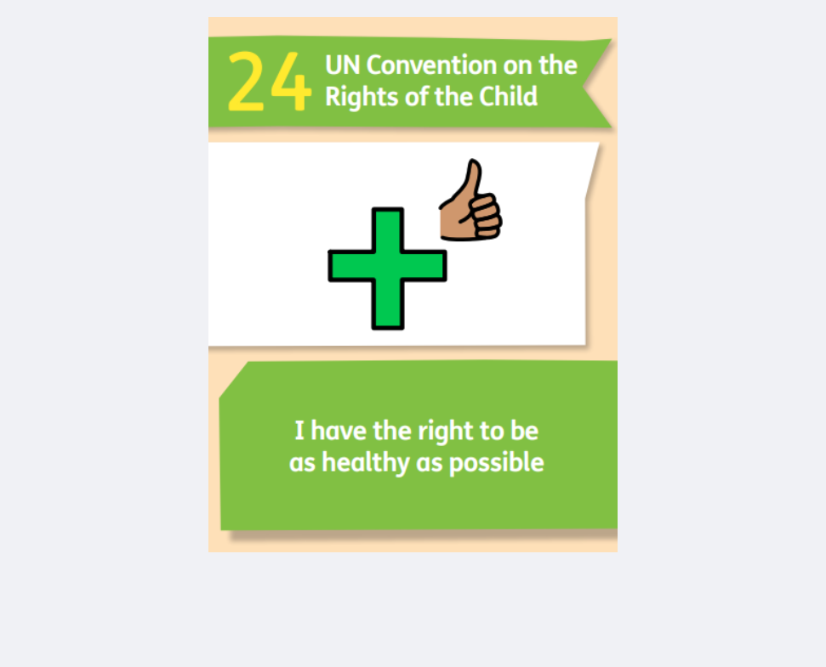
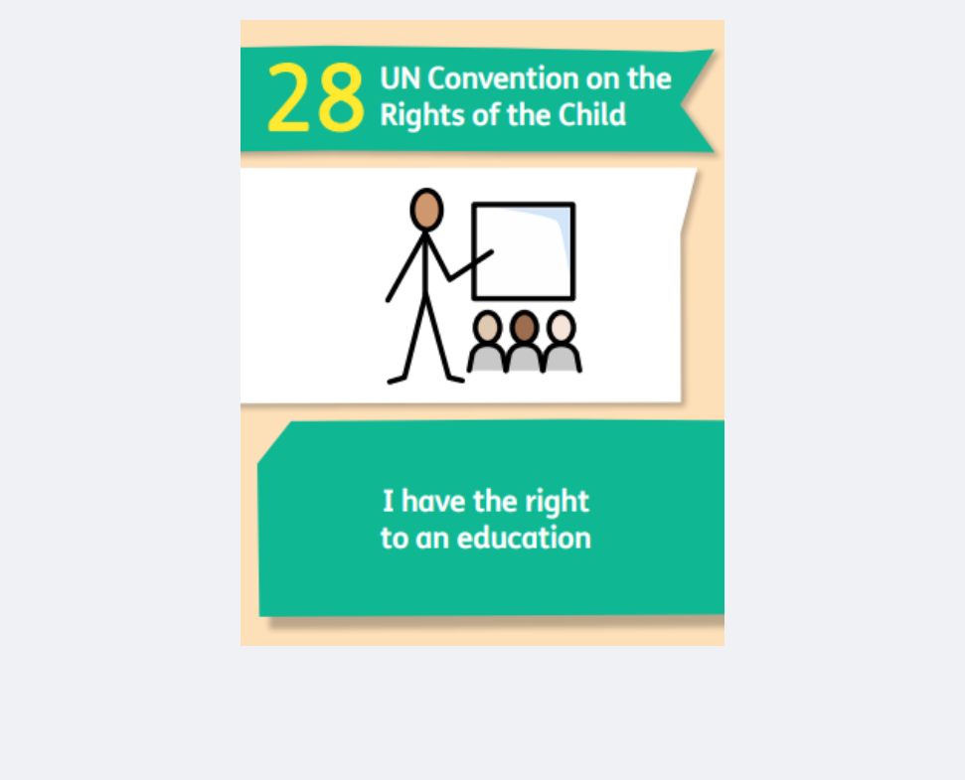
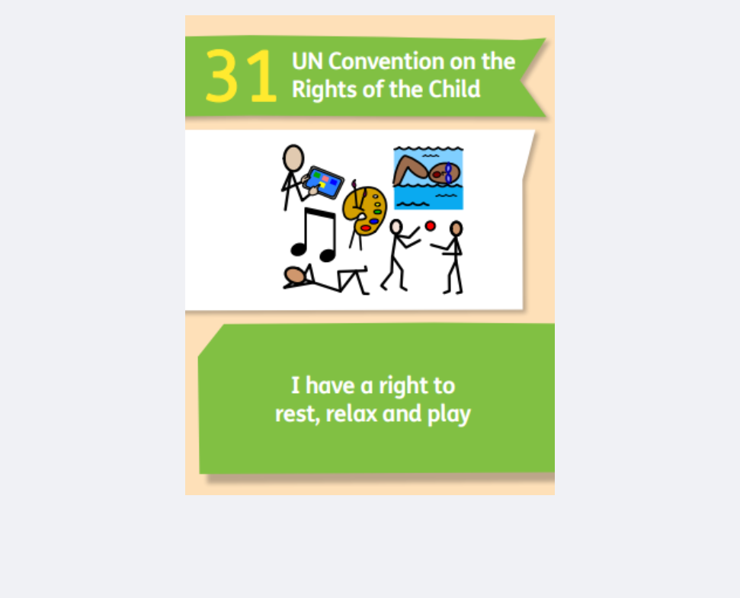
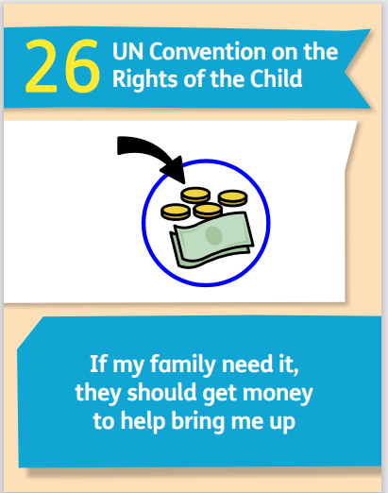
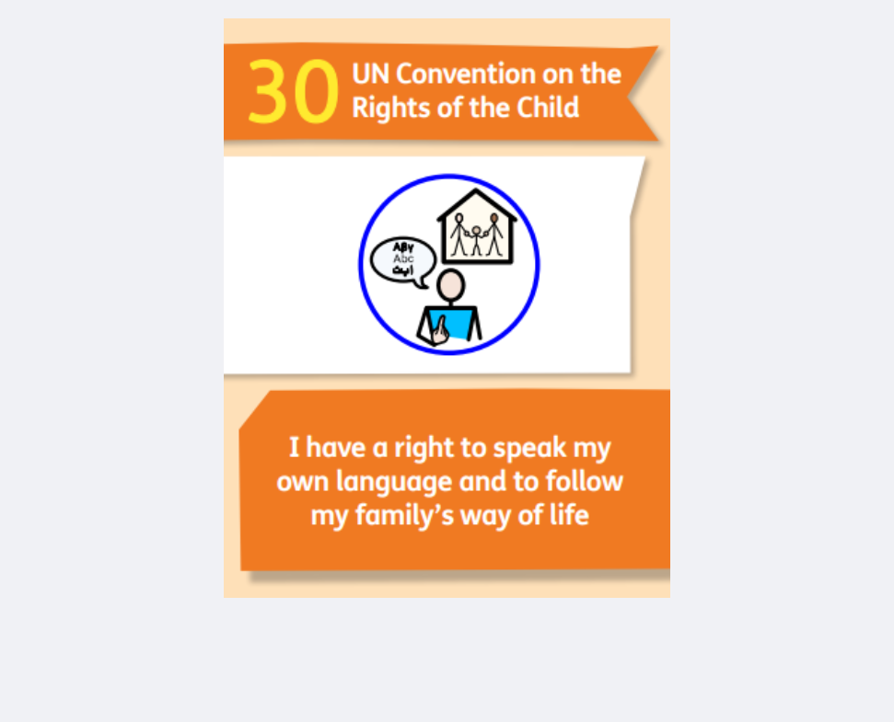
What do my rights have to do with elections?
Notes:
Hold a group discussion about the rights on the screen, ask pupils to think about how they might link to issues within Wales. Some of the ways that rights are effected by elections in Wales are on the following slides.

Slide 5
Politicians in the Senedd can make decisions affecting
lots of different issues linked to your rights, like:
  Healthcare in Wales
  Mental health support in schools
  Rules on the sale and use of vapes
  How junk food is displayed in shops

Slide 6
Politicians in the Senedd can make decisions affecting
lots of different issues linked to your rights, like:
  Financial help for families to buy school uniform and other things young people need for school
  Free School Meals

Slide 7
Politicians in the Senedd can make decisions affecting
lots of different issues linked to your rights, like:
  What you learn in school
  How much money schools have for different things

Slide 8
Politicians in the Senedd can make decisions affecting
lots of different issues linked to your rights, like:
How easy it is for people to learn Welsh, and to speak Welsh in their communities

Slide 9
Politicians in the Senedd can make decisions affecting
lots of different issues linked to your rights, like:
Youth clubs, activities for young people, and spaces to relax and play

Slide 10
Activity 2 – Having my voice heard
Notes:
Activity 2 – Having my voice heard

Slide 11
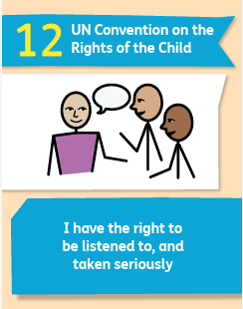




In your community/ across Wales
School
You have a right to be listened to and taken seriously.
Copy the map on the right.
Think about how you get your voice heard in school and in your community.
Notes:
Explain that one of your rights is to be listened to and taken seriously.
Ask students to think about other ways they can have their voice heard in their school and community and to add these to the map.

Slide 12
In your community/ across Wales
School
Pupil voice group
School survey
Elections
Contacting a local councillor/ Senedd member
Here’s some examples, you’ve probably thought of loads more....
Committees
Talking to teachers
Petitions
School council
Senedd Ieuenctid
Notes:
Discuss the examples of how students can have their voice heard.

Slide 13
Useful links
Learn more about the Youth Parliament - https://youthparliament.senedd.wales/get-involved/
Make a Petition - https://senedd.wales/senedd-business/petitions/creating-a-petition/
Write to your Senedd Member, MP, or local councillor - https://www.writetothem.com/
Register to Vote - https://www.registertovote.service.gov.uk/
Notes:
These links can be shared with students to support them to have their voice heard.

