Slide 1

The Senedd
Your Voice, Your Wales
Notes:
These short activities will explore the history and role of the Senedd.

Slide 2
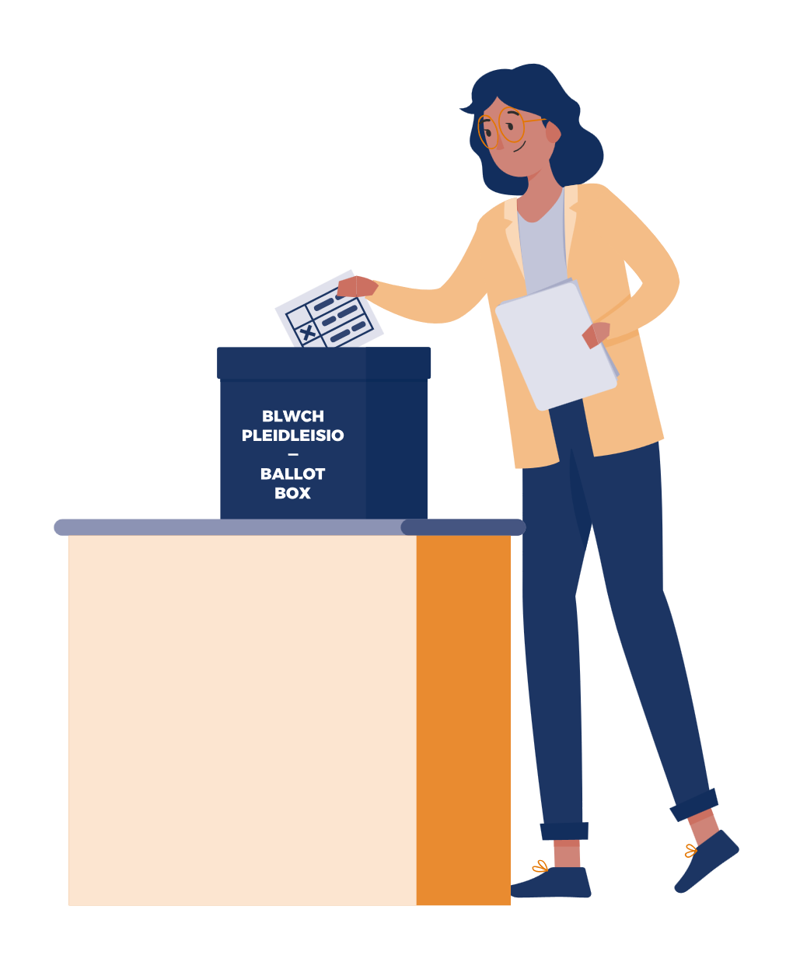
Senedd Election 2026
The next Senedd Election will be on 7 May 2026.
If you’re 16 by the 7 May and live in Wales – you will be eligible to vote in this election.
To cast your vote, you must register to vote by midnight on 20 April 2026
The Senedd makes decisions about things that affect you and your community
Notes:
This slide can be used to introduce the election.
The election will take place on 7 May 2026
You need to be 16, living in Wales and registered to vote to vote in this election
You will be voting for the political party or independent candidate you want to represent you in the Senedd
The Senedd makes decisions about your education, health, transport, housing, and the environment.

Slide 3

Activity 1:
History of the Senedd
Notes:
Activity 1 – History of the Senedd

Slide 4



Senedd Session 1:
History of the Senedd
Notes:
Play the video

Slide 5
Connect these statements to the correct dates
2020
950
1999
1997
The voting age in Senedd elections is lowered to 16-year-olds. The National Assembly for Wales is renamed the Welsh Parliament (commonly known as the Senedd) to reflect its status as a fully-fledged parliament.
A referendum was held on 18 September proposing the creation of a Welsh Assembly. The result was 50.3 per cent in favour, and 49.7 per cent against with a majority of just 6,721.
During the reign of Hywel Dda, the native laws of Wales were codified for the first time, meaning they were made more accessible to the public. The language of the laws was Welsh and the system of law was significantly different from England.
The National Assembly for Wales met for the first time on 12 May before its official opening by Her Majesty Queen Elizabeth II on 26 May. 24 of the 60 Assembly Members were female which had, until that point, been overwhelmingly male dominated.
Notes:
Ask students to connect the statements to the correct dates.
Answers are on the next slide.

Slide 6
Correct answers
950
1997
1999
2020
During the reign of Hywel Dda, the native laws of Wales were codified for the first time, meaning they were made more accessible to the public. The language of the laws was Welsh and the system of law was significantly different from England.
A referendum was held on 18 September proposing the creation of a Welsh Assembly. The result was 50.3 per cent in favour, and 49.7 per cent against with a majority of just 6,721.
The National Assembly for Wales met for the first time on 12 May before its official opening by Her Majesty Queen Elizabeth II on 26 May. 24 of the 60Assembly Members were female which had, until that point, been overwhelmingly male dominated.
The voting age in Senedd elections is lowered to 16-year-olds. The National Assembly for Wales is renamed the Welsh Parliament (commonly known as the Senedd) to reflect its status as a fully-fledged parliament.
Notes:
Correct answers:
950 - During the reign of Hywel Dda, the native laws of Wales were codified for the first time, meaning they were made more accessible to the public. The language of the law was Welsh and the system of law was significantly different from England.
1997 - A referendum was held on 18 September proposing the creation of a Welsh Assembly. The result was 50.3 per cent in favour, and 49.7 per cent against with a majority of just 6,721.
1999 - The National Assembly for Wales met for the first time on 12 May before its official opening by Her Majesty Queen Elizabeth II on 26 May. 24 of the 60 Assembly Members were female which had, until that point, been overwhelmingly male dominated.
2020 - The voting age in Senedd elections is lowered to 16-year-olds. The National Assembly for Wales is renamed the Welsh Parliament (commonly known as the Senedd) to reflect its status as a fully-fledged parliament

Slide 7
Activity 2:
Members of the Senedd
Notes:
Activity 2 – Members of the Senedd

Slide 8

Senedd Session 2:
Powers of the Senedd
Notes:
Play the video

Slide 9

Key question:
If I were a member of the Senedd, what law would I introduce?
Notes:
Support a 5 Minute discussion with pupils.
What is an issue in your local area or community you care about?
What things affect their friends and family?
What law would you introduce if you were a member of the Senedd to overcome/help this issue?
A law is a rule made by a government that people in a country or community are expected to follow. We have laws for lots of reasons, for example to keep us safe or protect our rights. Some examples:
You must wear a seatbelt when in a car
All children should go to school
You must recycle or throw away rubbish in the proper bins

Slide 10

Activity 3:
Powers of the Senedd
Notes:
Activity 3 – Powers of the Senedd

Slide 11

Notes:
Play the video

Slide 12












The Welsh
Language
Benefits
Sports
Tourism
Health
Food
Immigration
Environment
Education
Media
Housing
Crime and Policing
Notes:
Following along from the video, which of these subjects are Powers that the Senedd have to create laws on?
Correct answers are on the next slide.

Slide 13




The Welsh
Language
Benefits
Sports
Tourism
Health
Food
Immigration
Environment
Education
Media
Housing
Crime and Policing
Notes:
Show the answers and highlight the powers not crossed out which the Senedd makes decisions on.

Slide 14
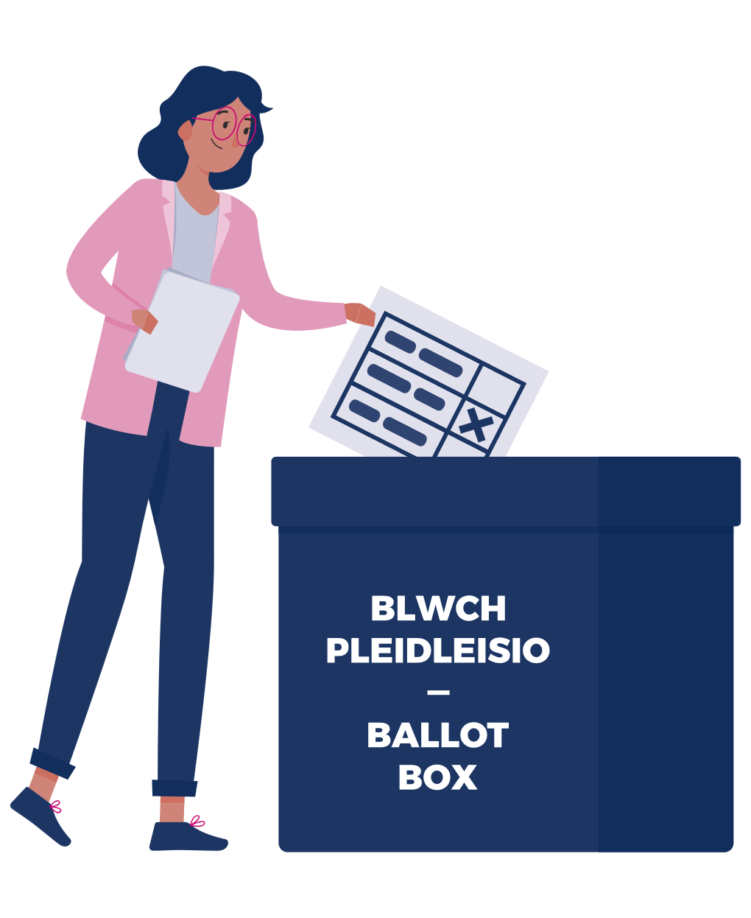
Activity 4:
Voting in the Senedd
Notes:
Activity 4 – Voting in the Senedd

Slide 15
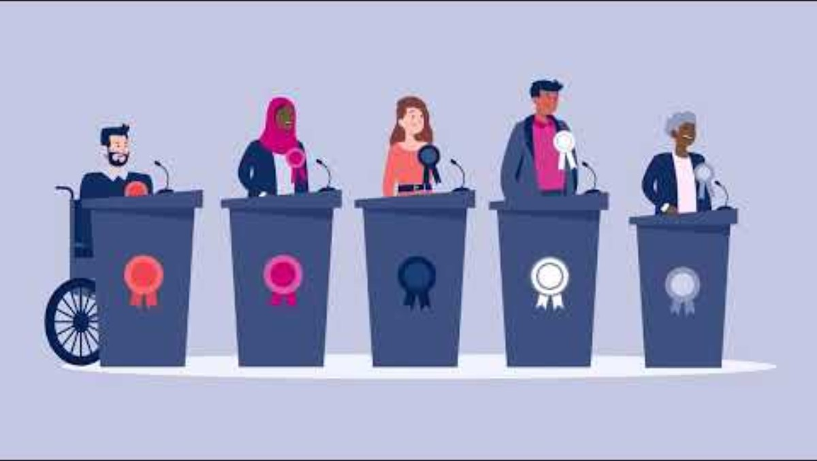
Senedd Session 2:
Voting in the Senedd
Notes:
Play the video

Slide 16
Is it important to vote?
Suffragettes
Make a protest
Discuss!
Be an active Citizen
Use your voice
Notes:
Support a 5 Minute discussion with pupils.
There are lots of reasons why it’s important to vote.
Ideas:
it’s your opportunity to use your voice
You can vote for the representatives you feel will make the best decisions for Wales
It’s a way to be an active citizen and be a part of making decisions for the country

