Slide 1




2026 Senedd Election
Assembly
Notes:
These assembly slides can be used to introduce the 2026 Senedd election and share key information about taking part.

Slide 2

Senedd Election 2026
The Senedd election will take place on Thursday 7 May 2026
You can vote if you're aged 16 and over on polling day and live in Wales
To cast your vote, you must register to vote by midnight on 20 April 2026
The Senedd makes decisions about things that affect you and your community
Notes:
This slide can be used to introduce the election.
The election will take place on 7 May 2026
You need to be 16, living in Wales and registered to vote to vote in this election
You will be voting for the political party or independent candidate you want to represent you in the Senedd
The Senedd makes decisions about your education, health, transport, housing, and the environment.

Slide 3
Senedd Election 2026
What are your rights and how do they relate to the election?
What does the Senedd do?
How can you vote in this election?
Notes:
Introduce what you will cover in the assembly.

Slide 4











Which of these do you have a right to?
Healthcare
Branded trainers
Clothes
Education
Chocolate
A safe place to live
Being able to
join clubs
Social media
Birthday presents
Being listened to
Notes:
Ask students to think about which of these they have a right to before showing the answers on the next slide.

Slide 5

Which of these do you have a right to?
Healthcare
Branded trainers
Clothes
Education
Chocolate
A safe place to live
Being able to
join clubs
Social media
Birthday presents
Being listened to
Notes:
Run through answers and highlight some of the key rights children have.
Highlight the right 'being listened to'. How might this link to taking part in elections?

Slide 6
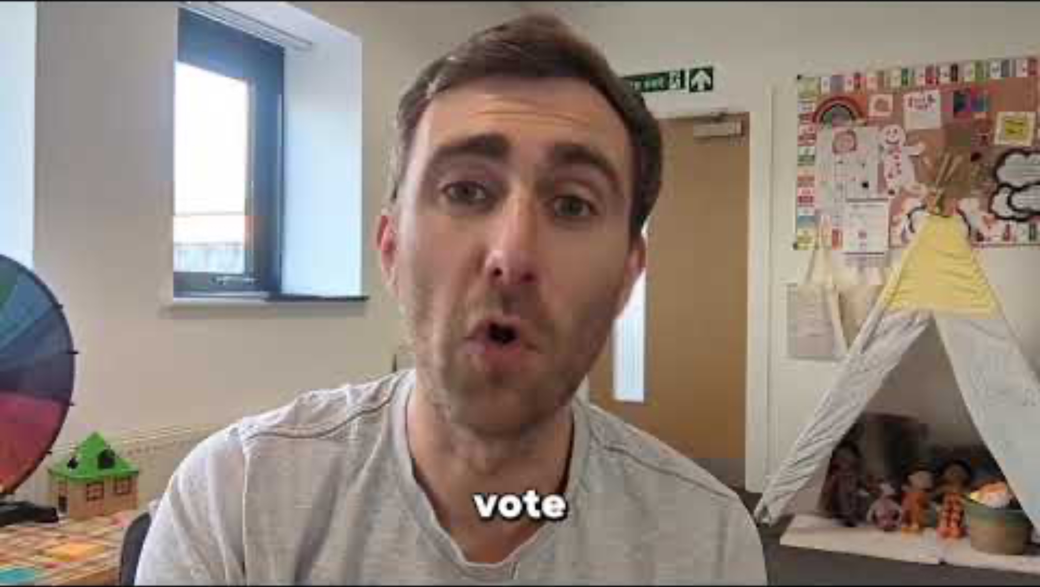
Notes:
Play the video.
Highlight that you have a right to have your say, and casting your vote in the Senedd election is one way you can have your say and make your voice heard.

Slide 7

What the Senedd does
Represents Welsh people and their interests
Makes sure the Welsh Government is doing its work properly
Makes rules for Wales (laws)
Pass (some) taxes
Notes:
Read this statement out about what the Senedd does.

Slide 8




What is the Senedd responsible for and what will you be voting for?
UK Parliament
Welsh Parliament
Notes:
Wales used to be governed by the UK Parliament in London. The UK Parliament used to make a lot of decisions here in Wales.
But since Welsh Devolution and the set up of the Senedd in Wales, this means the Senedd is able to make it’s own decisions on a lot of things that affect our everyday lives.

Slide 9












The Welsh
Language
Benefits
Sports
Tourism
Health
Food
Immigration
Environment
Education
Media
Housing
Crime and Policing
Notes:
What can the Senedd makes decisions on?
Look at the topics on the slide. Some are things the UK Parliament still makes decisions on here in Wales and others are things the Senedd makes decisions on.
Ask students which of the following aspects of our lives or powers do you think are decided by the UK government and which are decided by the Senedd in Cardiff Bay? Answers are on the next slide.

Slide 10
The Welsh
Language
Benefits
Sports
Tourism
Health
Food
Immigration
Environment
Education
Media
Housing
Crime and Policing
Notes:
Show the answers and highlight the powers not crossed out which the Senedd makes decisions on.

Slide 11
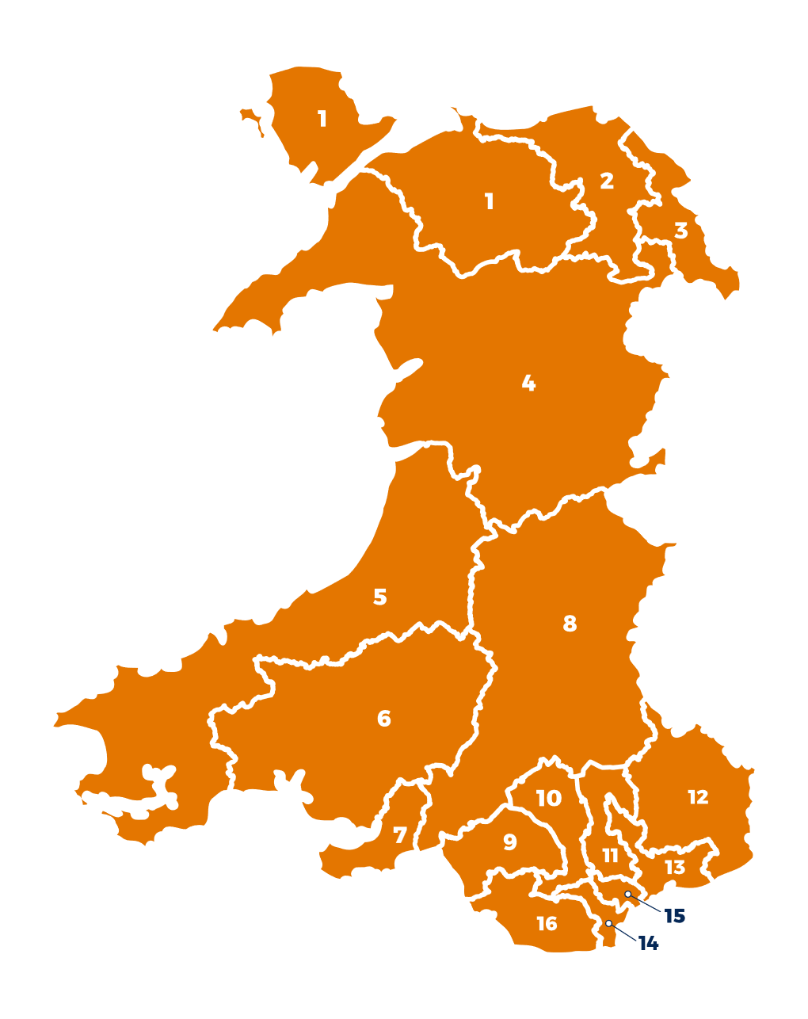
Members of the Senedd
Members of the Senedd are elected to represent us and our communities.
96 Members of the Senedd
16 Constituencies
6 Members of the Senedd in each Constituency
Notes:
Talk through the role of Members of the Senedd.

Slide 12






Who do I vote for?
Party manifestos will help you to decide who to vote for in the Senedd election.
You should vote for the party whose manifesto you agree with the most.
Vote for the policies that will make life better for you here in Wales.
Notes:
Explain how students can decide who to vote for.
They can check who they can vote for here - https://www.electoralcommission.org.uk/i-am-a/voter/your-election-information
The party / parties with most support will form a Government after the election and will be responsible for spending approx. £26 billion on services in Wales.

Slide 13
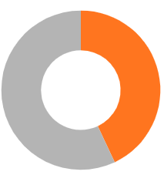
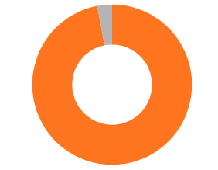
How many 16-17 year olds are registered to vote in Wales?
7%
43%
57%
Registered
16-17
+65
Not registered
93%
Notes:
Answer will reveal after click.
If you've already delivered the lesson plan, briefly recap this info and check if students can remember that only 43% of 16-17 year olds were registered to vote in 2024.
If this is new information to the group, ask learners what % of 16-17 year olds they think are registered before revealing the answer. You could also ask 60% of the group to raise their hand or stand up to demonstrate that this % of 16-17 year olds in Wales are not registered to vote to have their voice heard. Highlight that 16-17-year-olds in Wales are much less likely to be registered to vote than older voters and explain it’s important you know how to register to vote, so you can have your say.

Slide 14

Get prepared
Things to know
You can choose how to vote
In person - at a polling station
By post - send your vote in the post
By proxy - someone else votes on your behalf
Things to do
Decide how you’ll vote – in person, by post or by proxy
If you're voting in person, find your polling station
Put the date in your phone or school planner
Election day:
7 May 2026
Notes:
Explain these key steps to get prepared to vote.
You’re more likely to vote if you’ve planned how, when and where to do it.
The first step is to choose how you’ll vote, and there are a few options…
To vote by post you need to apply for a postal vote by Tuesday 21 April 2026. You can only apply to vote by proxy in certain circumstances. More information can be found on the Electoral Commission website - https://www.electoralcommission.org.uk/voting-and-elections/ways-vote
You can also find your polling station on the Electoral Commission website - https://www.electoralcommission.org.uk/i-am-a/voter/your-election-information

Slide 15
How to vote
Things to know
You get one vote and will be given one ballot paper
You will vote for the political party or independent candidate you want to represent you in the Senedd
Things to do
Always read your ballot paper – it tells you exactly what to do!
Ask for help at the polling station if you need equipment or support
Election day:
7 May 2026
Notes:
Talk through what to expect on polling day and how to vote.
Signpost learners to this video to find out more about how to vote in Senedd elections: https://vimeo.com/1121829010?fl=pl&fe=sh

Slide 16

Any questions?
Notes:
Answer any questions and remind students to register to vote.

Slide 17
Senedd Election 2026
The Senedd election will take place on Thursday 7 May 2026
You can vote if you're aged 16 and over and live in Wales
To cast your vote, you must register to vote by midnight on 20 April 2026
The Senedd makes decisions about things that affect you and your community
Notes:
Option to show slide with key info about the election again at the end.

